Slide 1
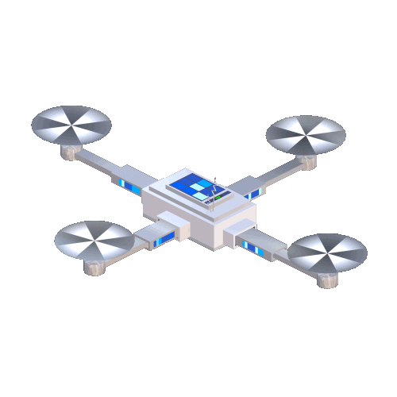
Control and Coordination of Multi-Drone Systems Using Graph Neural Networks
Masters Thesis Defense
By
Parth Khopkar
April 15, 2021

Slide 2
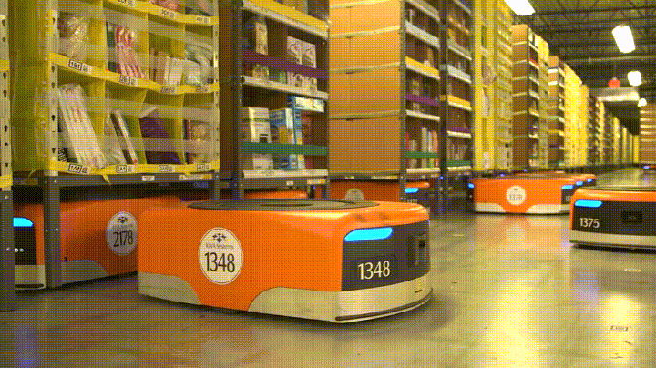
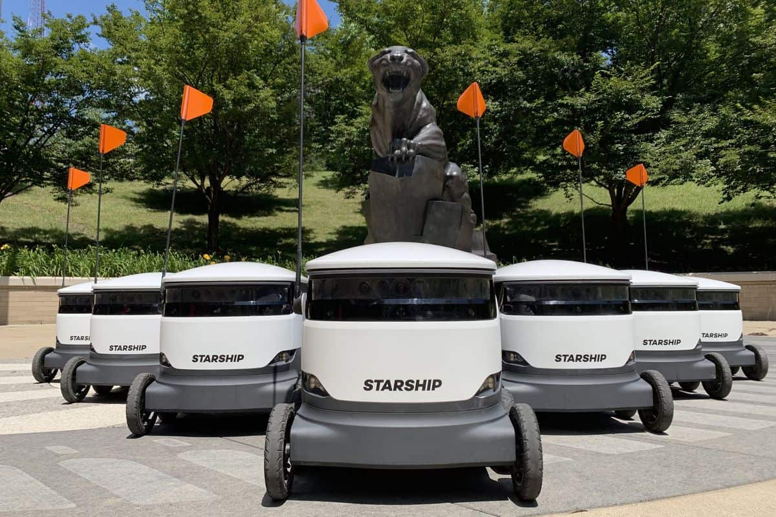
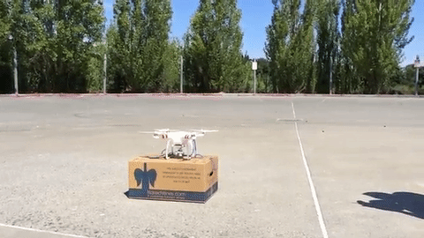
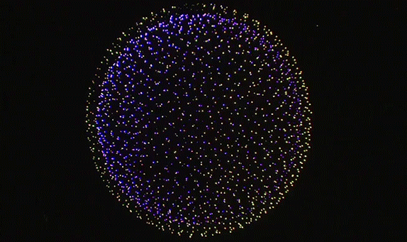
Warehouse robots
Delivery robots
Delivery drones
Drone light show (Intel)
Notes:
As these systems of robots become more prevalent, it is important to study and understand how to improve control strategies for them and coordinate their actions
My thesis focuses on a particular approach to do this with drones

Slide 3
What?
Collection of autonomous mobile robots working together to achieve a common objective
Coordinate their actions with each other to achieve a task that would be difficult for a single robot.
Why?
Multiple robots introduces redundancy
We want multi-robot systems for the same reason why humans collaborate – to achieve bigger goals than any single one of us can.
Notes:
Having seen the what and why, my thesis focuses on one way on “how” to do this

Slide 4
Constraints on MRS
According to Cortés and Egerstedt (2017), a MRS should satisfy following properties:
Local
Safe
Emergent
Scalable
Notes:
Local – individual robots can only act on information available to them
Safe – Robots should be safe from harm that might come from events such as collisions among themselves or environment
Emergent – Global properties should emerge from local interaction rules
Scalable – The algorithm used to control a single robot should not depend on the size of the entire team
I consider the principles as guiding principles while developing the proposed approach

Slide 5
Challenges in development and use
Earliest approaches used behaviors and functions handcrafted by experts.
With the advent of DL, NNs have been used as function approximators
Learning from scratch is expensive and often unfeasible for real multi-robot systems
Need to generalize and make the controller robust to real world challenges such as noise.

Slide 6
Imitation Learning with Boids model
[Reynolds ‘87]
Simulate the aggregate motion of a flock of animals
Behavior of each member of the flock is the result of interactions with their neighbors.
The acceleration generated by each member is superimposed to get the final acceleration of each boid
Our aim is to use the trajectories generated by this model to fly drone in a simulator
Cohesion
Separation
Alignment
Obstacle Avoidance
Goal seeking
Interactions in the Boids model
Notes:
Was developed by By Reynolds (1987 as a way to simulate a natural flock in computer animation as an alternative to scripting the behavior of individual members of the flock. The original paper referred to these simulated bird like or ”bird-oid” objects as ”boids”.

Slide 7
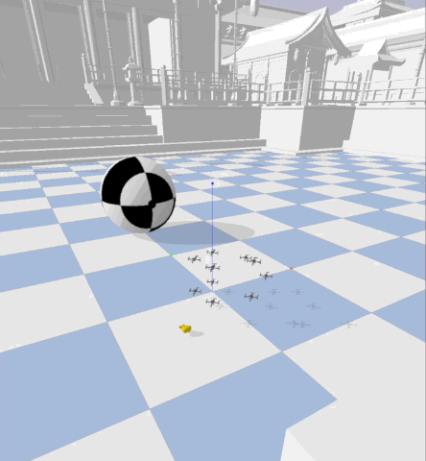
PyBullet Physics based simulator
Gym environment based on PyBullet for multi-agent learning with quadrotors
Gym interface allows for greater control over observations and actions
Support for realistic collisions
Comes with support for trajectory tracking and PID control
Notes:
PID control allows us to focus on high level behaviors. It takes care of drone flight dynamics Be on the lookout for the yellow rubber duck

Slide 8
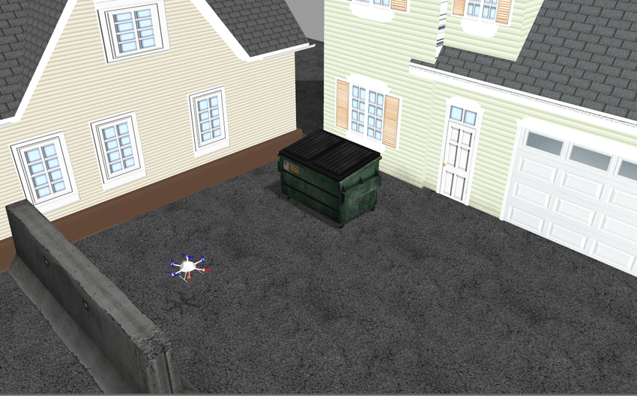
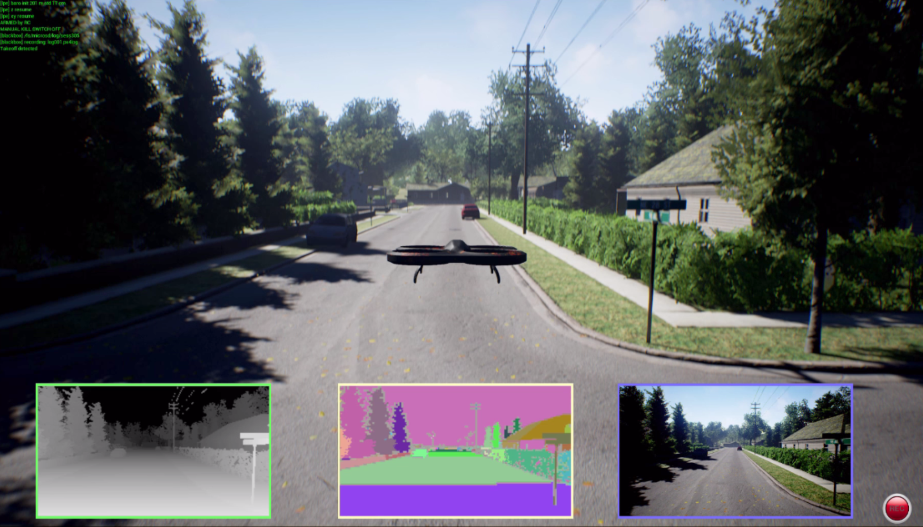
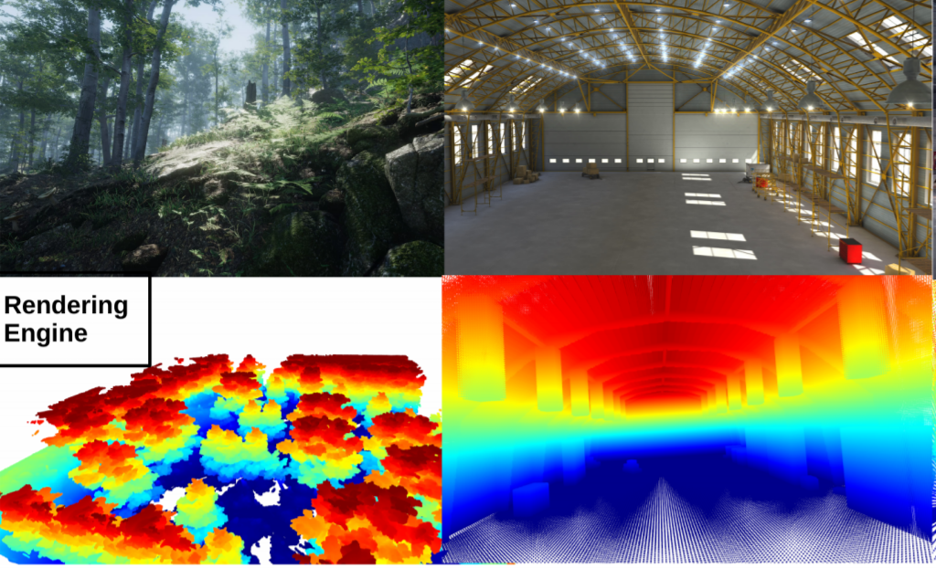
Why not other simulators
RotorS
ROS and Gazebo based simulator
Not parallelizable
AirSim
UE4 based simulator
Tight coupling between rendering and dynamics (no headless mode)
Flightmare
Unity based photorealistic simulator
Parallelizable
No support for multi-agent interfaces
Notes:
Flightmare is close but no multi-agent interface is a deal breaker

Slide 9
Graph Neural Networks (GNNs)
Function approximators that operate on graph-based data
Explicitly model the interaction dynamics of the entities present in the graphs
Used in areas with rich relational structures – Physics, Molecular Chemistry, Traffic Networks etc.
What makes them attractive – permutation invariance, locality
Input
Output
Graph
Neural
Network
Notes:
Need for inductive biases
Inductive biases in GNNs and how they help capture the intuition in MRS
Permutation invariant
locality

Slide 10
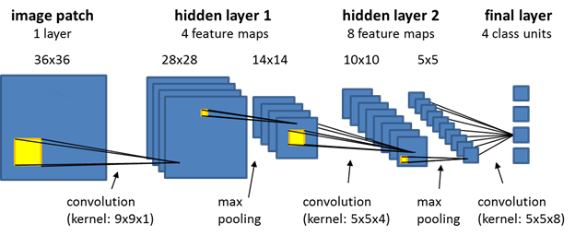
Convolutional Neural Networks (CNNs)
Operate on Euclidean spatial data
Recurrent Neural Networks (CNNs)
Operate on temporal data
NN structures produce inductive biases
Inductive biases in deep learning help to form better representations
It is easier to pick a good solution when there is less ambiguity

Slide 11
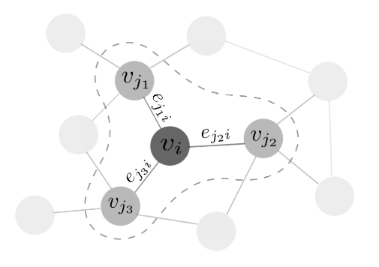
GNN operations
$e_{ji}^{t}=ϕ^{e}\left(v_{j}^{t},v_{i}^{t}\right)$ (1)
$\overline{e_{i}^{t}}=\sum_{j∈N_{i}}{e_{ji}^{t}}$ (2)
$h_{i}^{t}=ϕ^{v}\left(v_{i}^{t},\overline{e_{i}^{t}}\right)$ (3)
$y_{i}^{t}=ψ\left(h_{i}^{t}\right)$ (4)
$e$ : Edge state
$φ^{e}$ : Edge function
$N_{i}$ : Neighborhood of node $i$
$ψ$ : Read out function
$v$ : Node state
$φ^{v}$ : Node function
$h_{i}^{t}$ : Node embedding
$y_{i}^{t}$ : Desired output
Based on SwarmNet architecture by Zhou et al. (2019)
Notes:
Message Passing Neural Network

Slide 12
How GNNs model MRS
Graph $G=(N,E)$
$E=\left\{i,j \right| i,j∈N, i≠j\}$
Neighborhood of node: $N_{i}=\{j|\left(j,i\right)∈E\}$
Edges of type $x→b$ where $x∈\{o, g,b\}$ (obstacle, goal and boid)
MLP approximators - $φ_{o→b}^{e}$, $φ_{g→b}^{e}$, $φ_{b→b}^{e}$
$$φ_{o→b}^{e}$$
$$φ_{o→b}^{e}$$
$$φ_{b→b}^{e}$$
$$φ_{b→b}^{e}$$
$$φ_{b→b}^{e}$$
boid
boid
obstacle
obstacle
goal
goal
$$φ_{o→b}^{e}$$
$$φ_{o→b}^{e}$$
$$φ_{o→b}^{e}$$
Notes:
MRS due to their interactions can naturally be modelled as graphs

Slide 13
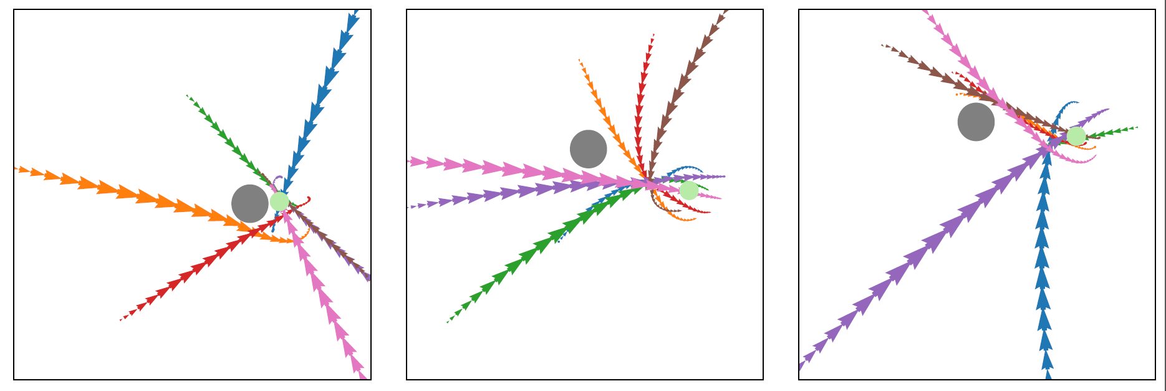
Trajectories in Boids model
Dimension: $T×N×D$ (Time steps $×$ Number of entities $×$ Dimension)
State vector $s_{i}\left(t\right)=[x_{i}\left(t\right), \dot{x_{i}}(t)]$ (coordinate and velocity vectors)
$s∈ℝ^{4}$
Sample Boids trajectories
Notes:
We sample states from the Boids model at discrete time steps to from the trajectories

Slide 14
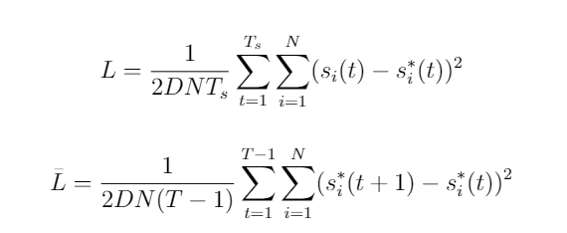
Loss function
MSE loss $L$ normalized by $\overline{L}$ ($L_{norm}=L/\overline{L}$)
Normalization rectifies dependence of error on sampling frequency of the trajectory

Slide 15
Training and Inference
Training
Repeatedly train the model on the trajectories with increasing prediction horizon
e.g. For 36 step trajectory, model is trained for prediction steps = 1, 2, 4, 8, 16
This is necessary to ensure that the GNN learns to faithfully clone Boids model
Inference
Single step prediction based on current state is used as input to PID controller

Slide 16
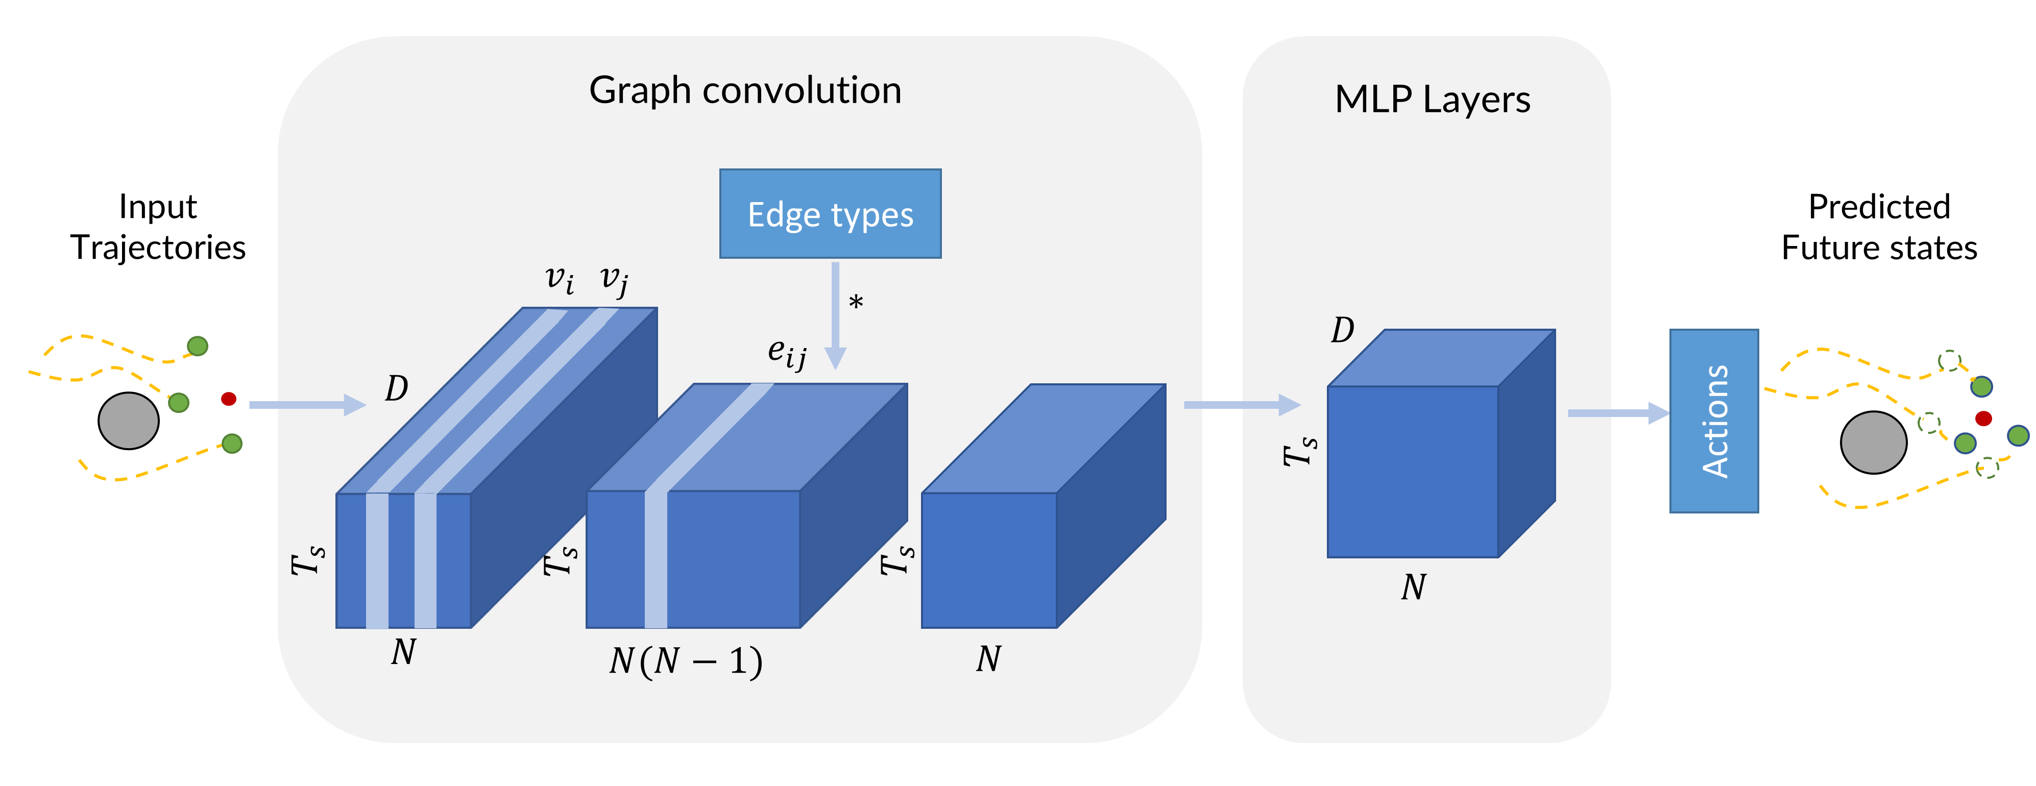
Network Architecture
+

Slide 17
System Architecture
Agent
states
Graph Neural Network
Controller
Predict
Velocity
PID controller
Next state
Context
Updated states in the simulator

Slide 18
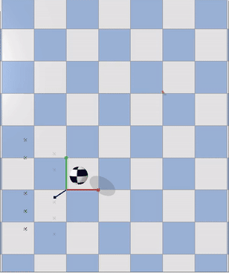
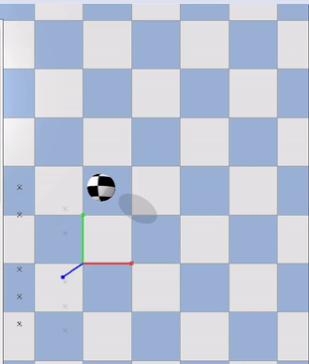
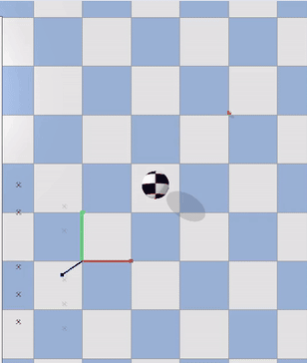
Results on direct transfer
The GNN based controller is capable of controlling drones directly after
Imitation Learning training
Notes:
Drones are able to generalize to varying positions of the obstacles

Slide 19
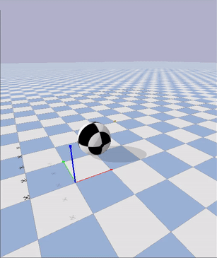
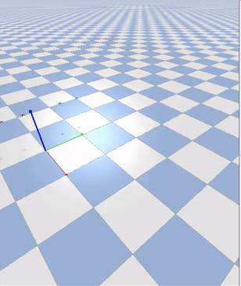

Slide 20
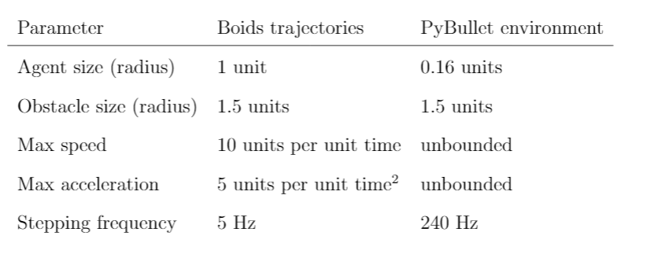
Parameter differences
36 steps
575 steps
Important to adjust key parameters between Boids trajectories and PyBullet simulator
Importance of stepping frequency
Low frequency in Boids trajectory captures same behaviors in fewer steps
Avoiding collisions in PyBullet simulator by adjusting size
Size of boid in training data is kept high since size is more of a “comfortable distance” for the Boids model

Slide 21
Reward function
To quantify the performance of the drones in the simulator, following reward function is used:
Size of drone
Size of obstacle
Large cost for collision
Distance between
Drone $i$ and $j$
$$ρ, α, β, γ>0$$

Slide 22
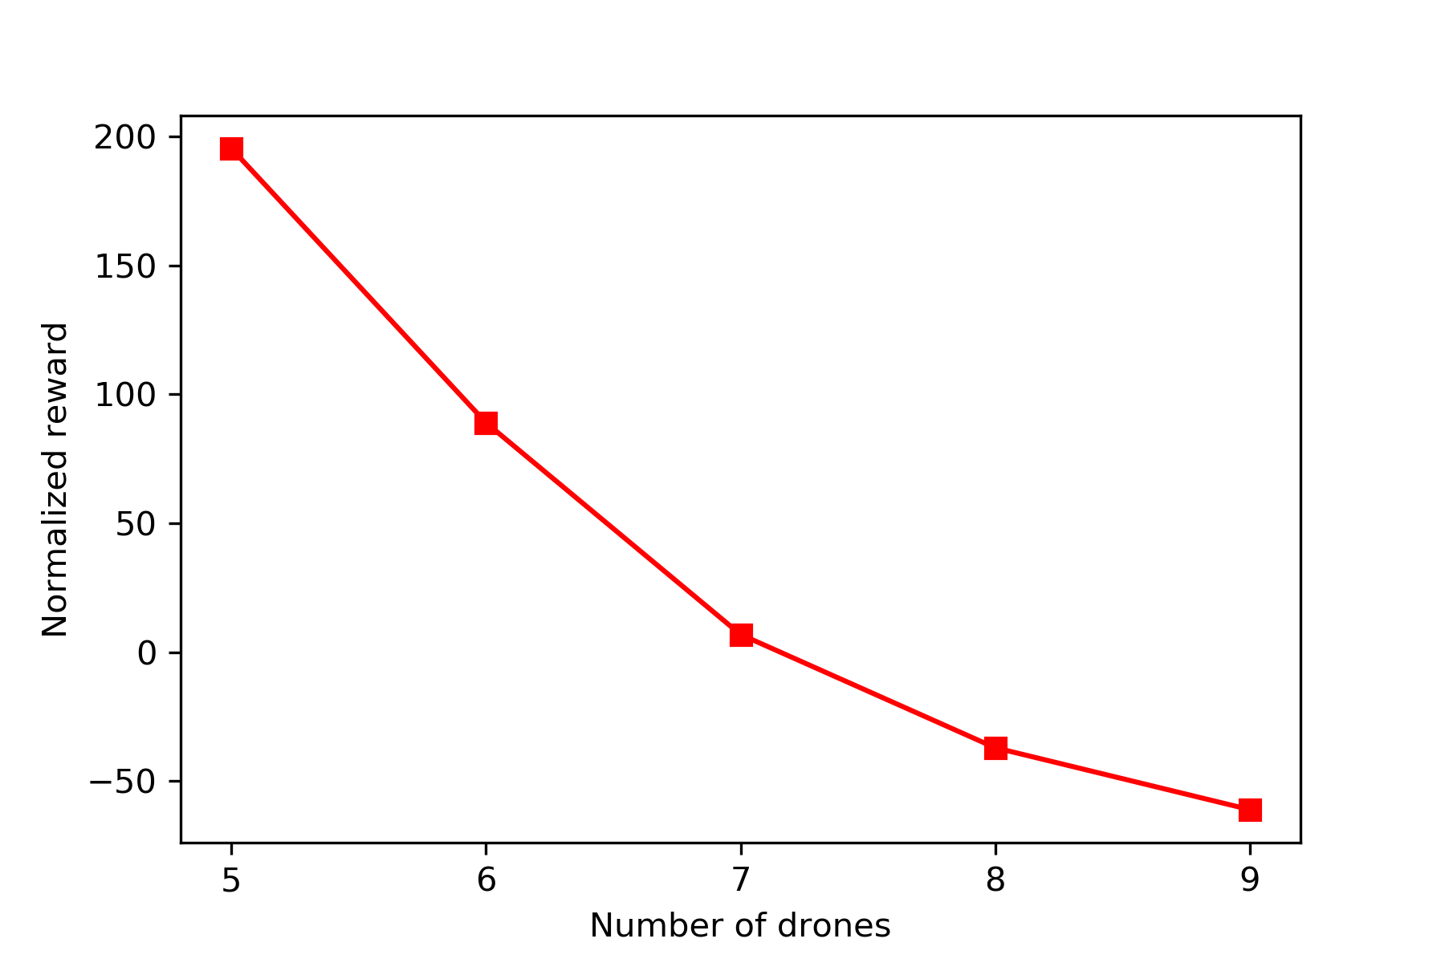
Scalability
GNNs provide scalability by default as opposed to other approaches
Possible since the update equations of GNNs do not depend on size of graph
Due to the poor ability of MLPs to extrapolate, the performance degrades
Controller trained on N=5 drones tested on more drones
Notes:
Important to understand this performance

Slide 23
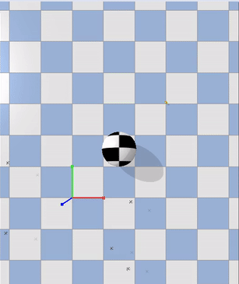
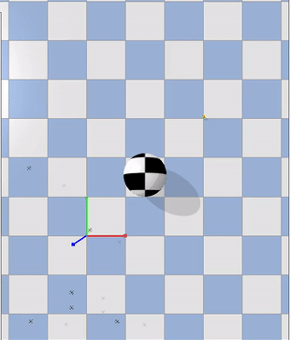
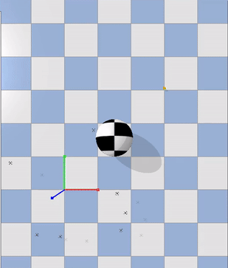
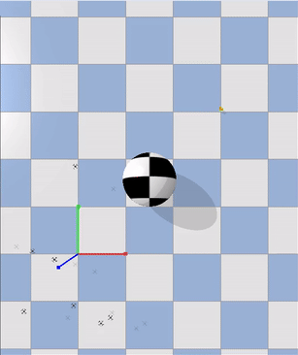
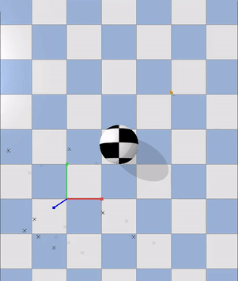
N = 5
N = 6
N = 7
N = 8
N = 9
Notes:
Drones are not able to navigate as well but underlying behaviors of Boids model are still visible. No collisions

Slide 24
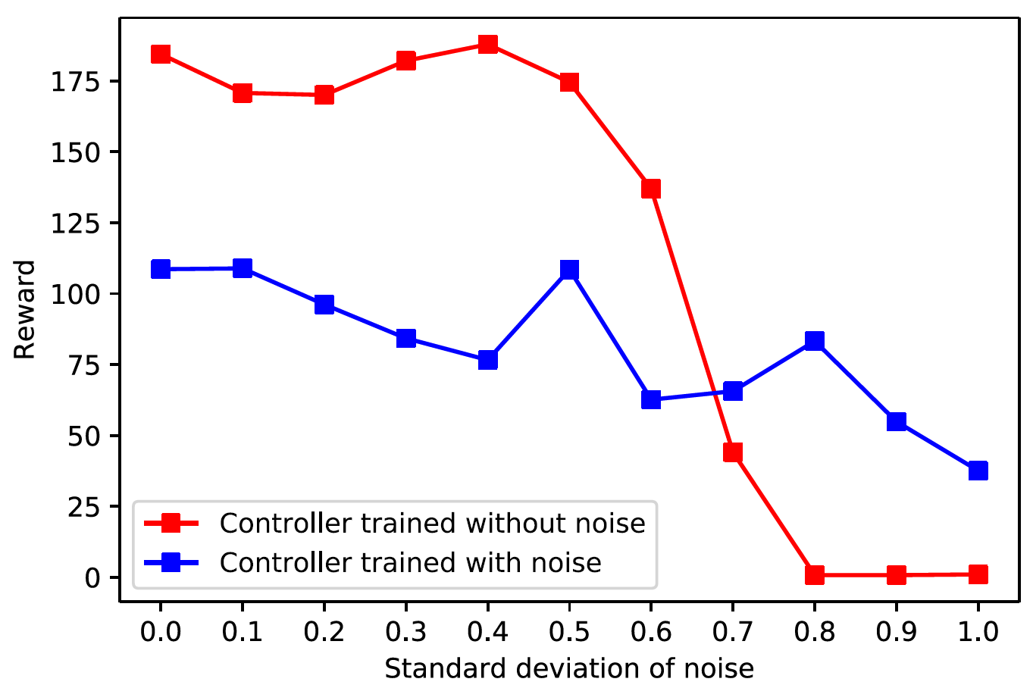
Robustness
In real life scenarios, sensor noise is bound to be present
Due to communication issues
Due to presence of adversarial elements
Experiments with distributed control and noise
Each drone receives perfect observations for own state but noisy observations for all other entities in the environment
To combat noise, controller was trained on Boids trajectories with randomly sampled Gaussian noise $N(0, 0.1)$
Controller trained with noise shows a more graceful performance degradation but gets lower reward overall
It learns to take more conservative paths

Slide 25
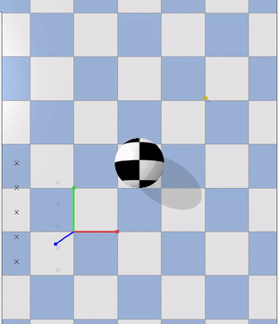
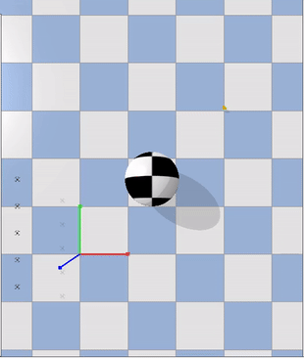
Both controllers tested on noise with std = 0.8
Controller trained without noise
Controller trained with noise

Slide 26
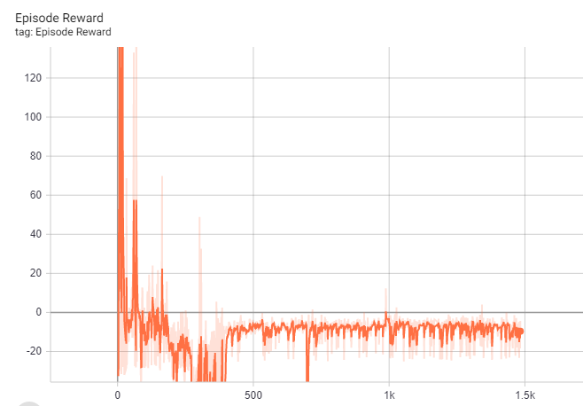
Reinforcement Learning for combating noise
Reinforcement Learning on Imitation Learning trained controller
Idea: Since IL has already learned correct behaviors, use RL to teach it how to deal with noise
Use Proximal Policy Optimization (PPO) algorithm for RL
Lock $φ_{g→b}^{e}$ edge MLP and pretrain value function using IL policy self-play
Start training process keeping $φ_{g→b}^{e}$ locked
Notes:
We can take advantage of the function separation in GNNs

Slide 27
Results
The reward is initially high because of IL trained policy
As training goes on, RL erodes behaviors learnt during IL, leading to performance drop
Directly using Reinforcement Learning after Imitation Learning is not ideal for our use case because:
It is counter-intuitive to let the controller forget and learn new behaviors
For use cases such as flying drones which is non-ergodic, it is imperative that the initial training performance is not poor.
Intuition
Switching the learning signal from supervised loss to reward signal (which are inherently different mathematical signals) causes divergence
Possible solution
Use demonstrations along with collected experience during Reinforcement Learning
Notes:
But we leave that as future work

Slide 28
Summary
GNNs can be used to leverage the problem structure inherent in Multi-Robot Systems
Imitation Learning combined with GNNs can be used to directly control drones in a Physics based simulator
The proposed approach is capable of scaling up and dealing with sensor noise to some extent

Slide 29
Future Work
Deploying on real drones
Exploring challenges for real life applications such as target location
Adding vision perception capabilities
Exploring how a more sophisticated approach to Reinforcement Learning combined with demonstration data can help better deal with noise

Slide 30
Thank You

